Slide 1


Dance Competition Capture in 3D: Phase 1
Arthur Murray Dance Studios
Adrian Persad
Team 1
Muna Aghamelu, James Zhong and John Backwell

Slide 2
Abstract
Prototype type: Image processing
Subtypes: Research, Data Analysis, Graphics, hardware, Algorithms
Abstract:
Identify the hardware and spatial requirements and limitations of rigging a space with suitable
sensors, with the goal of creating a fully 3D rendering of multiple participants dancing at once and
support playback from every angle. The system should be fair and reliable, and able to help the
process of judging professional dance competitions. Ideally, should support partner based dancing
and multiple dancers.
Main technologies:
Unity, C#, Kinect v2 SDK, Depth sensors on Kinect v2, Blender, Visual Studio

Slide 3
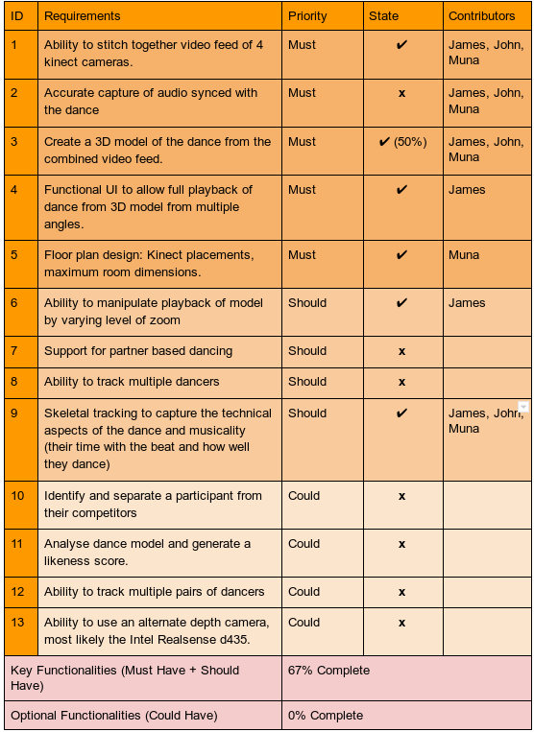
Achievements

Slide 5
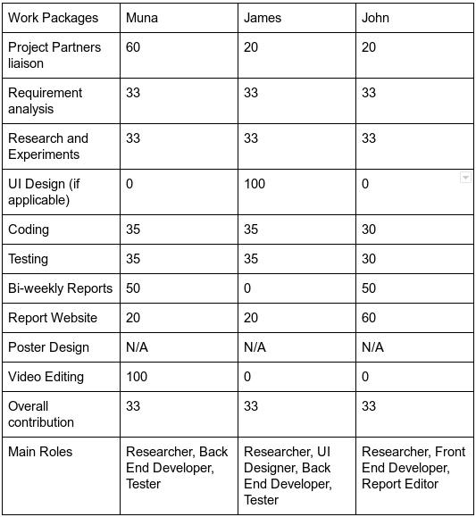
Contribution distribution

